Slide 1
Income & Employment Factors Exploratory Analysis of U.S. Census Data
Kayla Tucker & Makendra Crosby

Slide 2
Problem Statement
This project analyzes demographic and work-related factors that may influence whether an individual earns more or less than $50K per year.
Why this topic matters:
Income inequality is an important social issue. Understanding how attributes like age, education, occupation, and work hours correlate with income can provide insights into labor economics.
Dataset Overview:
Source: Adult Income dataset (UCI Machine Learning Repository)
Rows: ~48,842 individuals
Features: 14 demographic and employment-related variables
Target Variable: Income (≤ $50K or > $50K)

Slide 3
Loading the dataset and performing initial data analysis
Challenges:
Loaded from Hugging Face, HF_TOKEN warning appeared but did not affect loading.
Dataset Overview:
~32,000 rows, 15 columns
Mix of categorical and numerical features
Key features: age, workclass, education, marital-status, occupation, race, sex, hours-per-week
Target: income (>50K or ≤50K)
Weight column: fnlwgt
Data Types:
Numerical: age, fnlwgt, education-num, hours-per-week
Categorical: workclass, occupation, marital-status, native-country, etc.
Initial Observations:
Numerical features have reasonable ranges (e.g., age spans late teens to older adults)
No true missing values; “?” used as unknown in some categorical features
Dataset is clean and balanced, suitable for exploratory analysis and predictive modeling

Slide 4
Any extra steps performed before doing exploratory data analysis
~32,000 rows, no sampling needed
No null values, “?” used as placeholders in some categorical columns
Categorical columns manageable: sex (2), race (few), workclass/occupation (more)
Continuous variables (age, hours-per-week, capital-gain/loss) have realistic ranges, outliers need checking

Slide 5
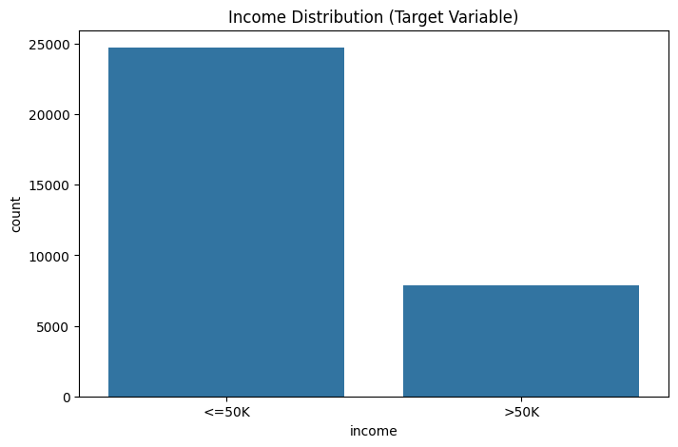
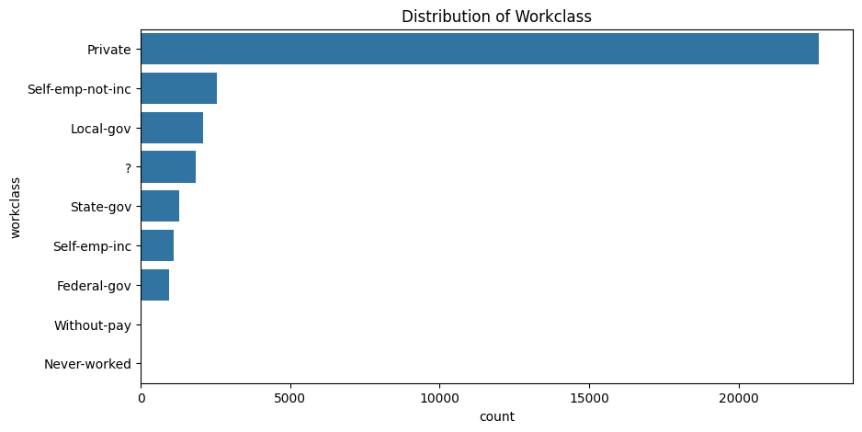
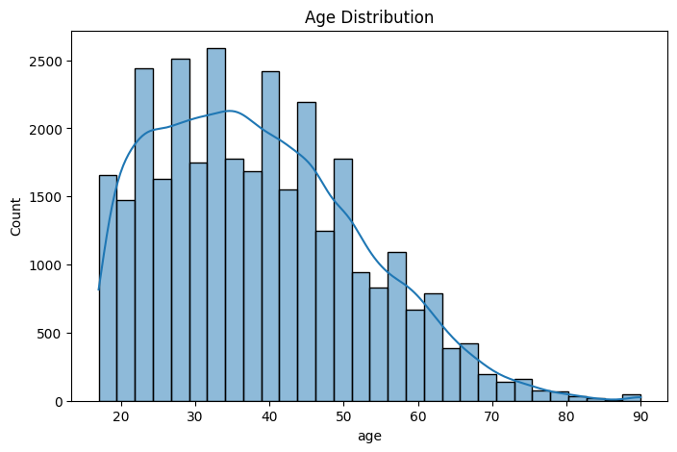
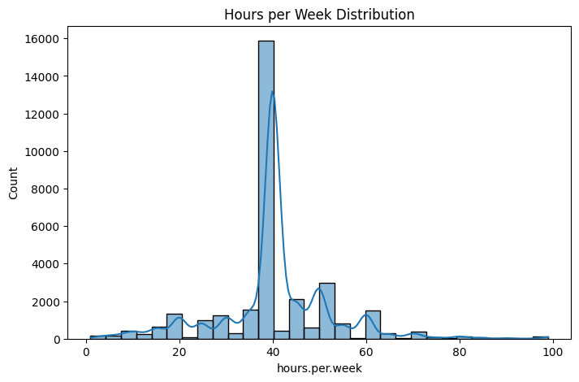
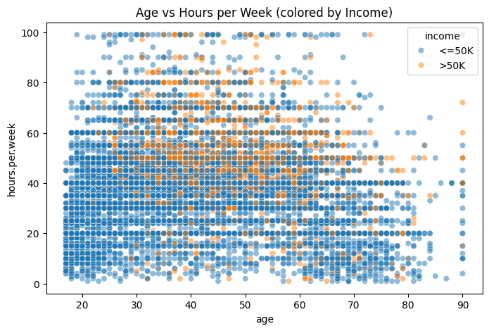
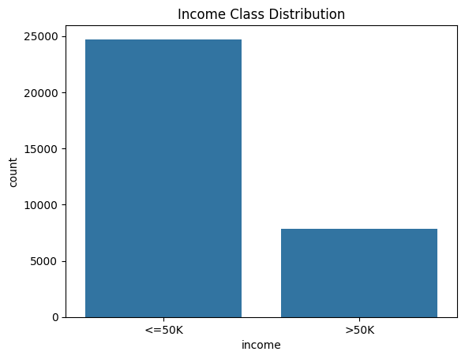
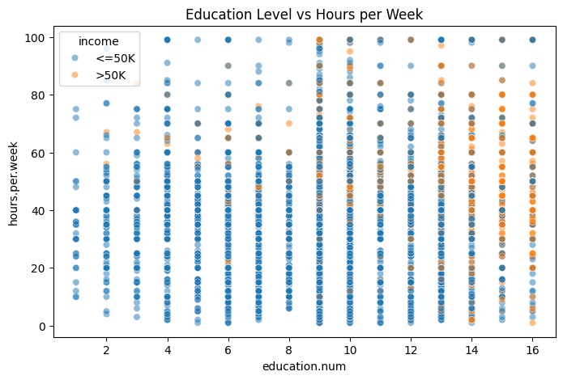
Visualizations
Univariate Analysis – Categorical variables
Univariate Analysis – Continuous variables
Bivariate Analysis - Scatter Plot
Data Skew/ Class imbalance
Linearity vs non-linearity between features

Slide 6
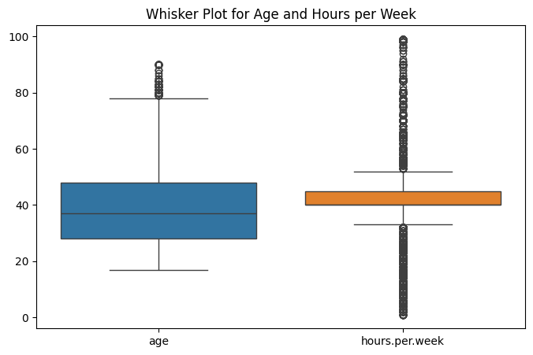
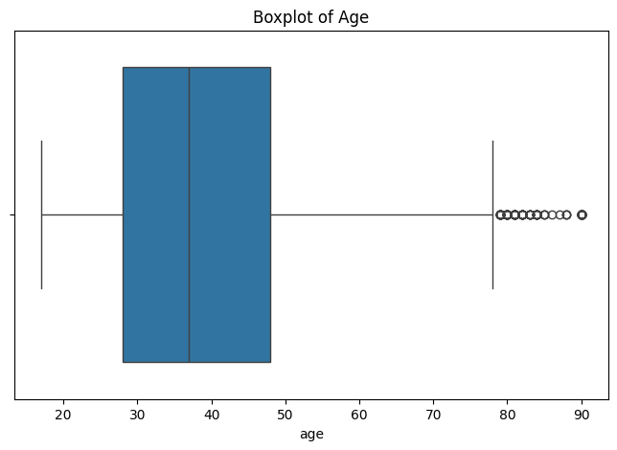
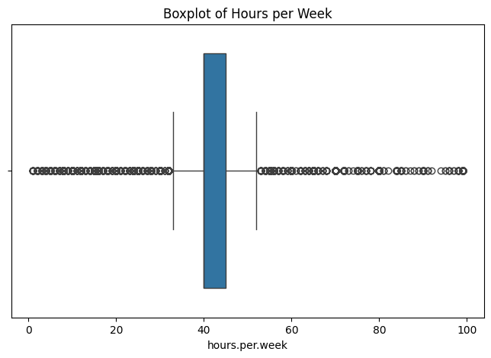
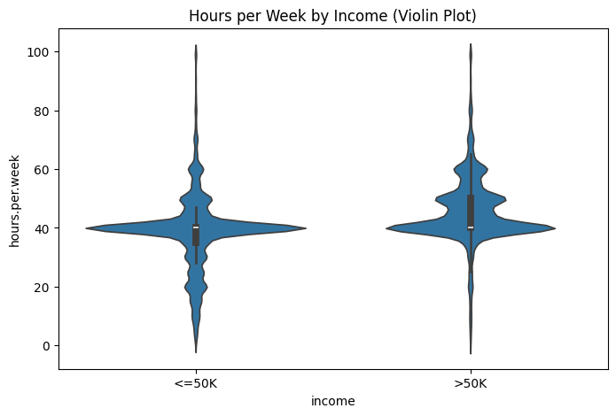
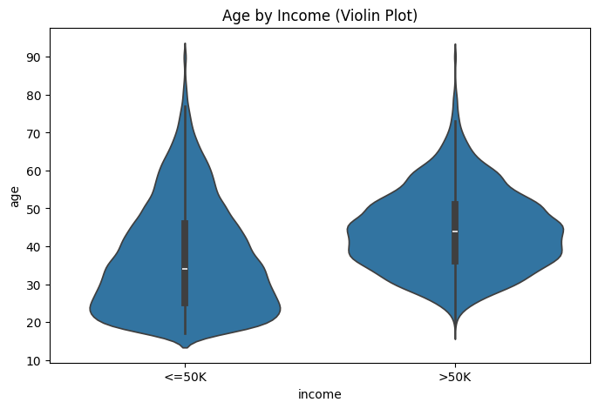
Outlier detection visualization
Box plot(s)
Whisker plot
Violin plot(s)

Slide 7
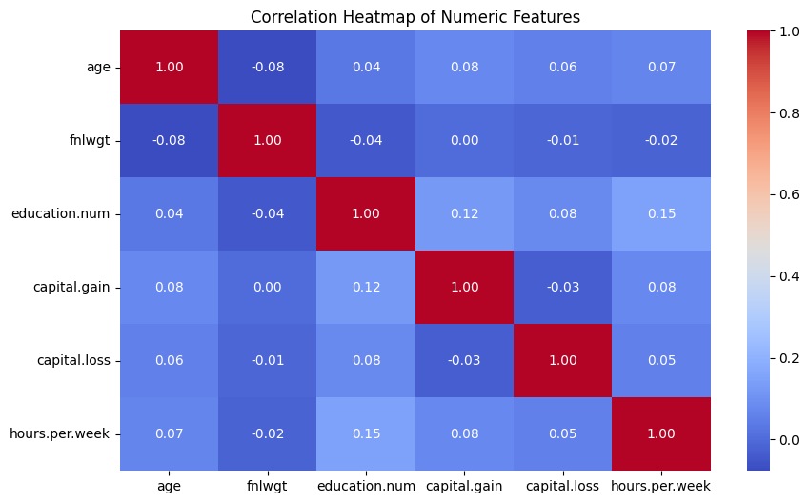
Multivariate Analysis

